Slide 1


CS 235: User Interface Design April 2 Class Meeting
Department of Computer Science San Jose State University Spring 2015 Instructor: Ron Mak
www.cs.sjsu.edu/~mak

Slide 2
Prototype Presentation Reports
A short report:
What is your application.
What UI design patterns did you use and why.
Describe up to 5 patterns.
Screen shots that illustrate your design patterns.
Your PowerPoint slides, if any.
Your prototype code, if runnable by anyone.
Include installation and how to run instructions.
Due Friday, April 3 (after Spring Break)

Slide 3
Midterm Solution: Question 1
What are the hazards of inside-out design? Briefly describe what you think it means to do “outside-in” UI design instead. What are the advantages of outside-in design over inside-out design?
Inside-out: Developers’ mental model of how the application is supposed to work is unlikely to match the users’ mental model.
Outside-in: Another name for user-centered design. Developers try to understand the users’ mental model.

Slide 4
Midterm Solution: Question 2
Consider the microwave oven and the bread toaster, two common kitchen appliances with familiar user interfaces. Compare and contrast the user experience (UX) design of the two appliances, particularly with regard to how and when users set the appliance controls.
Microwave oven: Precise but complex digital control that the user must set each time before cooking.
Toaster: Simple but imprecise analog control that the user can set once and reuse the setting for toasting the same type of bread each time.

Slide 5
Midterm Solution: Question 3
Consider the main Edit drop-down menu of a word-processing program. Within the context of UI design patterns and principles from cognitive science, discuss the pros and cons of making that a dynamic menu.
Pros: The menu items allow the user to do only what is permissible. The user doesn’t have to recall what he can or cannot do.
Cons: The menu changes are hidden. If they’re different each time the menu drops down, the user can’t learn from repeated precise practice.

Slide 6
Midterm Solution: Question 4
Examples:
Wizard pattern
Overcome limitations of working memory.
Overcome infrequent practice.
User’s attention highly focused and selective while using a wizard.
Grid of equals
Overcome limitations of working memory.
Convey function via recognition.

Slide 7
Midterm Solution: Question 5
The Apple website: http://www.apple.com Select any three UI design patterns that you see on that site. Name each pattern and give a short description of how the pattern is applied.
Examples:
Feature, search, and browse organization
Pyramid navigation
Visual framework
Grid of equals
Tiled sections
Carousel

Slide 8
Midterm Solution: Question 6
Suppose you are doing a usability test for the website of the Department of Computer Science: http://www.sjsu.edu/cs/. Briefly describe two use cases you could ask a tester to perform. What problems do you think the tester may encounter, and how would you fix those problems?
Many possible use cases.
Many problems found.
Be sure to stay within the CS Department website.

Slide 9
Mobile Application Prototypes
Each team develops a prototype for a smart phone mobile application of your own choosing.
Send me your app name and a short one- or two-sentence description.
Demo schedule:
Tuesday, April 21
Unknown, Uxability, X Factor
Thursday, April 23
Innovative Designers, Team Four, Thundercats

Slide 10
Mobile Application Prototypes, cont’d
Use prototyping tools.
Or use the mobile app development tools.
Apple: https://developer.apple.com/library/ios/referencelibrary/GettingStarted/RoadMapiOS/FirstTutorial.html
Android: https://developer.android.com/training/basics/firstapp/index.html

Slide 11
Mobile-Centric Thinking
Unique characteristics of a mobile user interface:
Small screen size (smart phone)
Touch screen
Gestures
iOS, Android, and Windows Phone have distinct design conventions.
Recommendation: Spend at least 6 weeks using each OS before starting a design.

Slide 12
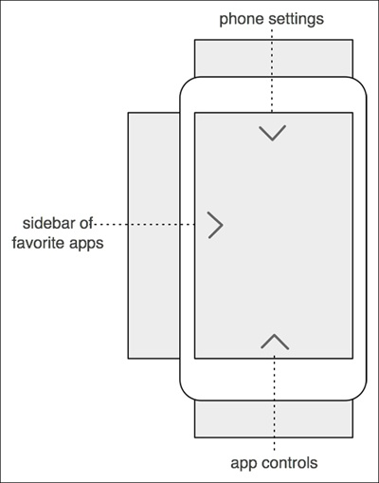
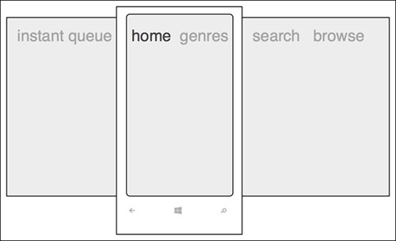
Designing with Small Screens
The screen is a window onto larger content that can’t all fit at once.
Mobile Design Pattern Gallery, 2nd ed.
by Theresa Neil
O’Reilly, 2014

Slide 13
Navigation Types
Persistent
Simple on-screen menu structures.
Used for primary navigation from one major category to another within an app.
Transient
Must be explicitly revealed with a tap or gesture.
Conserve space with a small screen size.

Slide 14
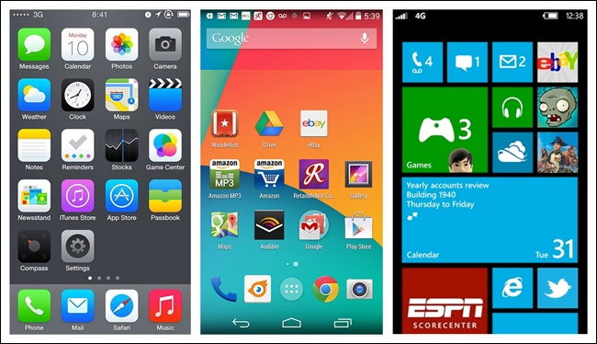
Persistent Navigation: Springboard
Combine the grid and menu page design patterns.
iOS
Android
Windows
Mobile Design Pattern Gallery, 2nd ed.
by Theresa Neil
O’Reilly, 2014

Slide 15
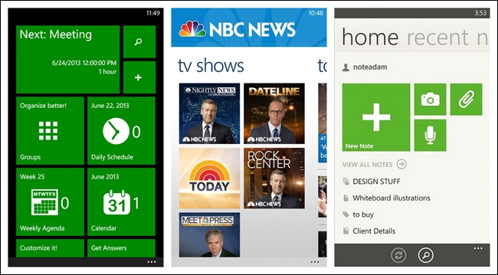
Persistent Navigation: Springboard, cont’d
Tiled menu page (Windows Phone):
CalendarPro
NBC News
Evernote
Mobile Design Pattern Gallery, 2nd ed.
by Theresa Neil
O’Reilly, 2014

Slide 16
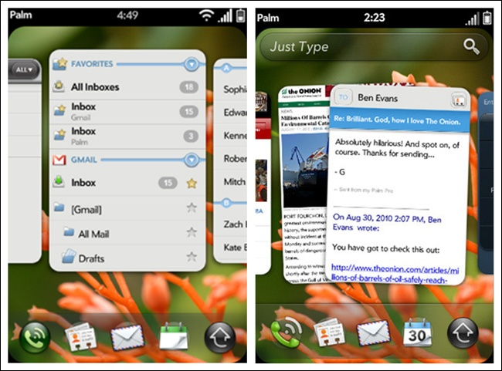
Persistent Navigation: Cards
Card deck metaphor
Stacking, shuffling, discarding, flipping, etc.
Palm webOS
Mobile Design Pattern Gallery, 2nd ed.
by Theresa Neil
O’Reilly, 2014

Slide 17
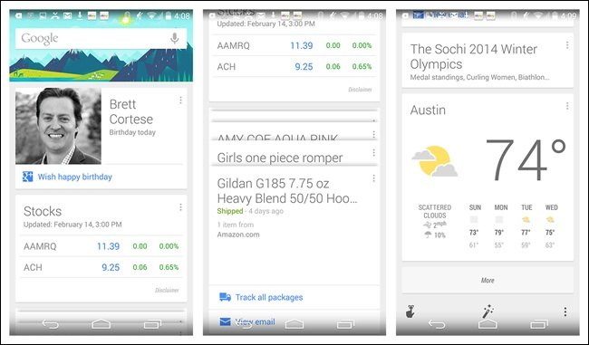
Persistent Navigation: Cards, cont’d
Cards can be used for primary navigation.
Google Now for Android
Mobile Design Pattern Gallery, 2nd ed.
by Theresa Neil
O’Reilly, 2014

Slide 18
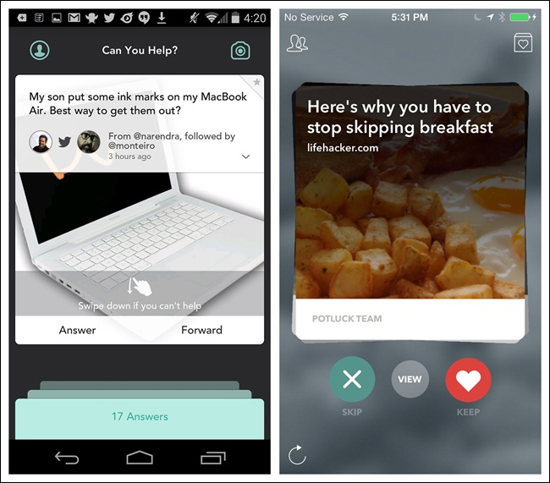
Persistent Navigation: Cards, cont’d
Swipe to move or remove cards.
Jelly
for iOS
Potluck
for iOS
Mobile Design Pattern Gallery, 2nd ed.
by Theresa Neil
O’Reilly, 2014

Slide 19
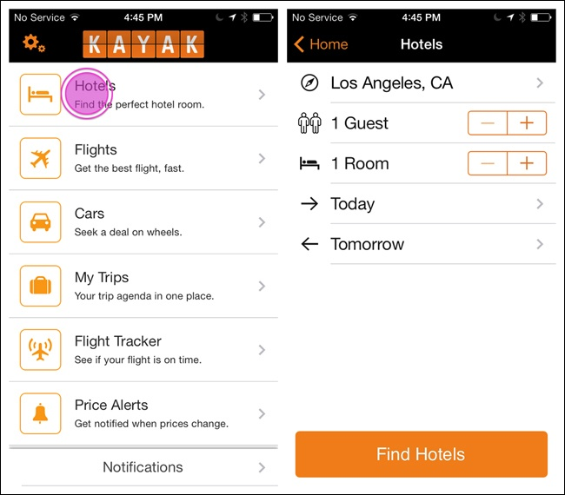
Persistent Navigation: List Menu
Similar to a springboard, but can be hierarchical.
Kayak
for iOS
Mobile Design Pattern Gallery, 2nd ed.
by Theresa Neil
O’Reilly, 2014

Slide 20
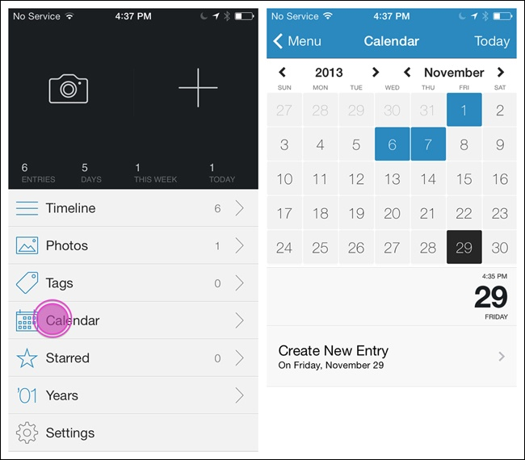
Persistent Navigation: List Menu, cont’d
Day One
for iOS
Mobile Design Pattern Gallery, 2nd ed.
by Theresa Neil
O’Reilly, 2014

Slide 21
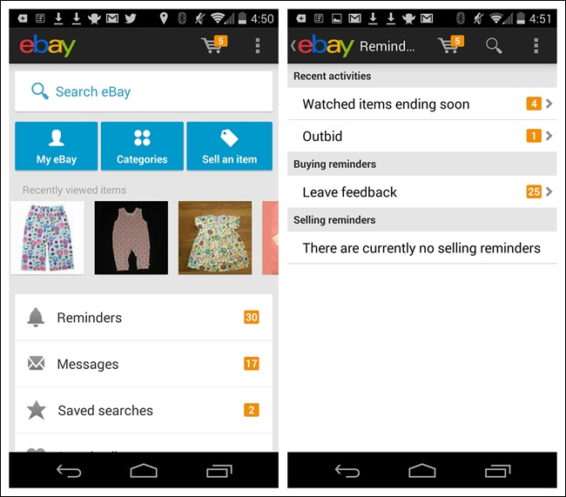
Persistent Navigation: List Menu, cont’d
Android: The “up” button is the “back” button.
Conveys hierarchy.
eBay
for Android
Mobile Design Pattern Gallery, 2nd ed.
by Theresa Neil
O’Reilly, 2014

Slide 22
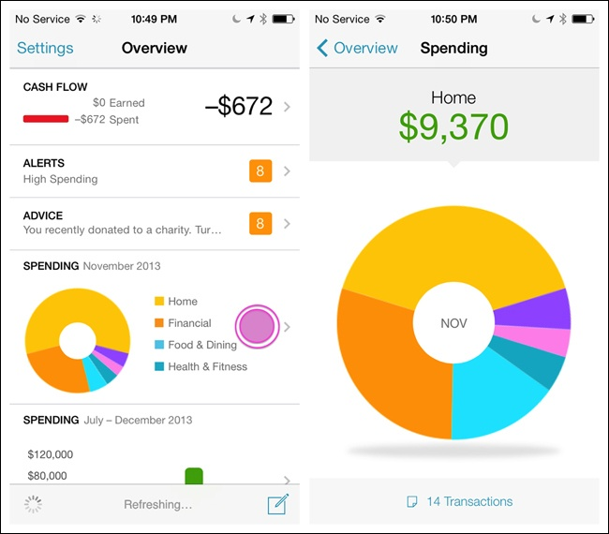
Persistent Navigation: Dashboard
A quick glance gives a snapshot of the most relevant information.
Similar to a springboard and a list menu.
Mint for iOS
Mobile Design Pattern Gallery, 2nd ed.
by Theresa Neil
O’Reilly, 2014

Slide 23
Persistent Navigation: Gallery
Display live visual content.
News stories, recipes, photos, etc.
Arranged in a grid, carousel, or slideshow.
Non-hierarchical
Frequently updated.

Slide 24
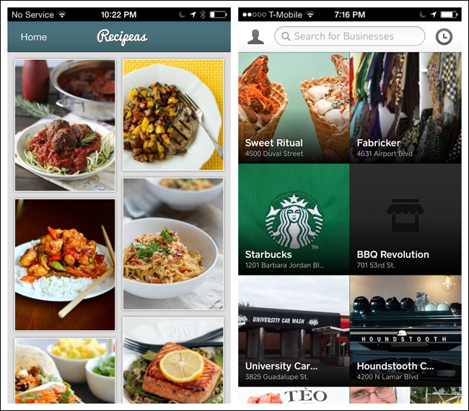
Persistent Navigation: Gallery, cont’d
Recipeas
for iOS
Square Wallet
for iOS
Mobile Design Pattern Gallery, 2nd ed.
by Theresa Neil
O’Reilly, 2014

Slide 25
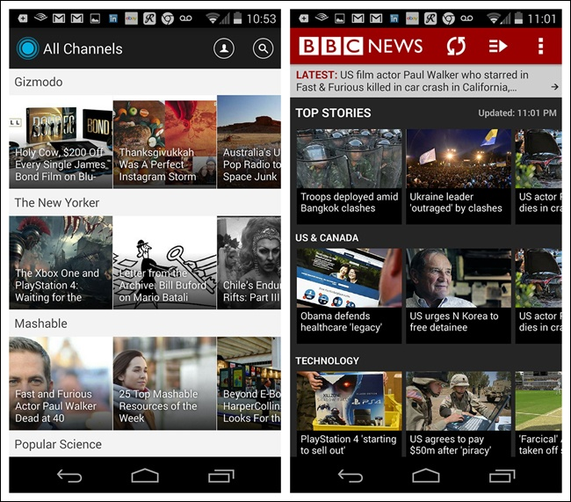
Persistent Navigation: Gallery, cont’d
Which is easier to read?
LinkedIn Pulse
for Android
BBC News
for Android
Mobile Design Pattern Gallery, 2nd ed.
by Theresa Neil
O’Reilly, 2014

Slide 26
Persistent Navigation: iOS Tab Menu
Tab bar to navigate “flat apps”.
Limited to five menu items.
“More” option as the fifth item.
“Call to action”: A highlighted menu item.
Tool bar
Presents tools or actions for a specific screen.
Mobile Design Pattern Gallery, 2nd ed.
by Theresa Neil
O’Reilly, 2014

Slide 27
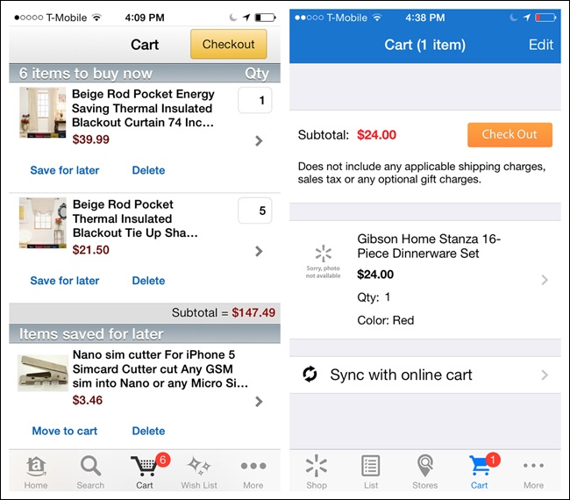
Persistent Navigation: iOS Tab Menu, cont’d
Amazon
for iOS
Walmart
for iOS
Mobile Design Pattern Gallery, 2nd ed.
by Theresa Neil
O’Reilly, 2014

Slide 28
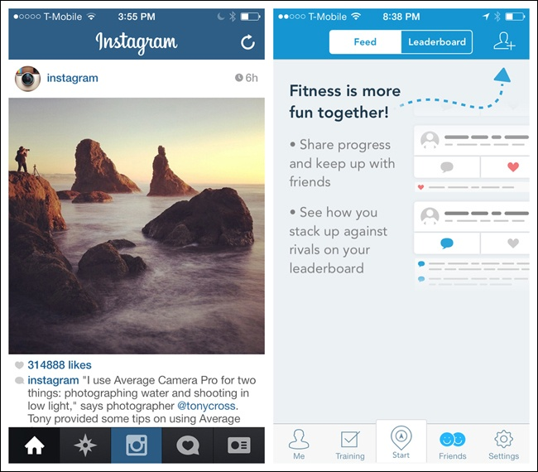
Persistent Navigation: iOS Tab Menu, cont’d
Calls to action
Instagram
for iOS
RunKeeper
for iOS
Mobile Design Pattern Gallery, 2nd ed.
by Theresa Neil
O’Reilly, 2014

Slide 29
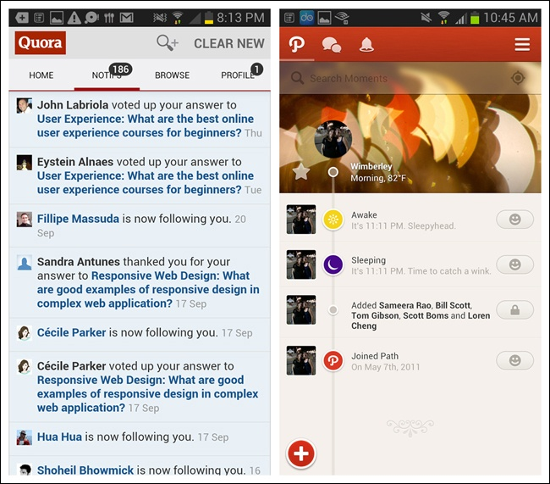
Persistent Navigation: Android Tab Menu
Fixed tabs for primary navigation
Quora
for Android
Path
for Android
Mobile Design Pattern Gallery, 2nd ed.
by Theresa Neil
O’Reilly, 2014

Slide 30
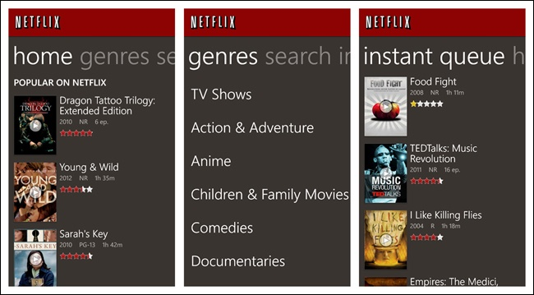
Persistent Navigation: Windows Tab Menu
App tabs pivot control
Mobile Design Pattern Gallery, 2nd ed.
by Theresa Neil
O’Reilly, 2014

Slide 31
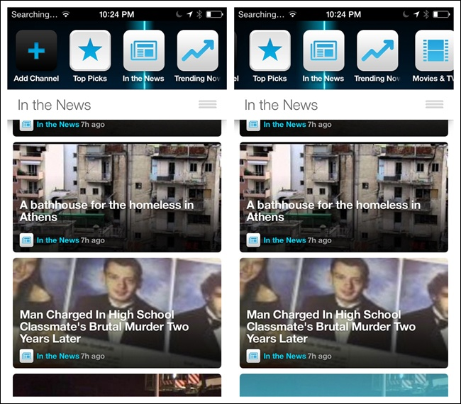
Persistent Navigation: Configurable Tabs
Users can add, delete, and rearrange tabs.
Frequency
for iOS
Mobile Design Pattern Gallery, 2nd ed.
by Theresa Neil
O’Reilly, 2014

Slide 32
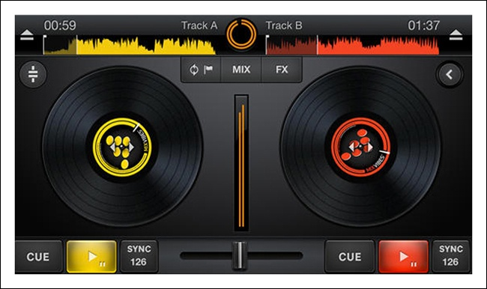
Persistent Navigation: Skeuomorphism
Skeuomorphic: An interface designed to appear like its real-world counterpart.
Cross DJ
for iOS
Mobile Design Pattern Gallery, 2nd ed.
by Theresa Neil
O’Reilly, 2014

Slide 33
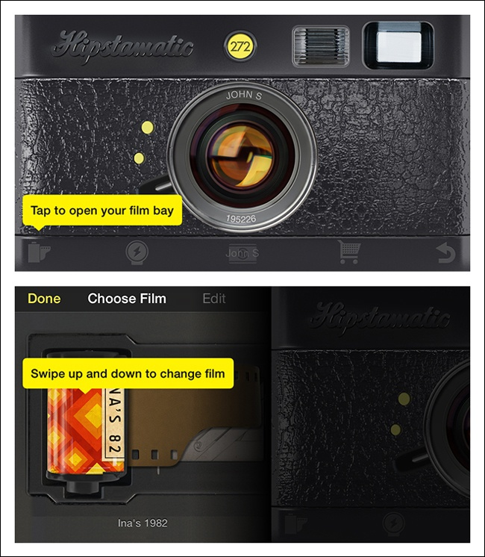
Persistent Navigation: Skeuomorphism, cont’d
Emulate a real-world object.
Hipstamatic
for iOS
Mobile Design Pattern Gallery, 2nd ed.
by Theresa Neil
O’Reilly, 2014

Slide 34
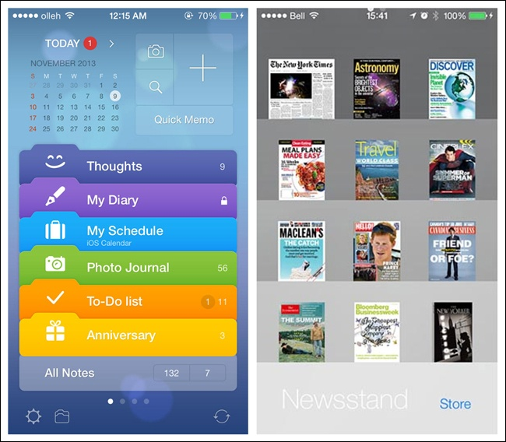
Persistent Navigation: Skeuomorphism, cont’d
Awesome Note
for iOS
Newstand
for iOS
Mobile Design Pattern Gallery, 2nd ed.
by Theresa Neil
O’Reilly, 2014

Slide 35
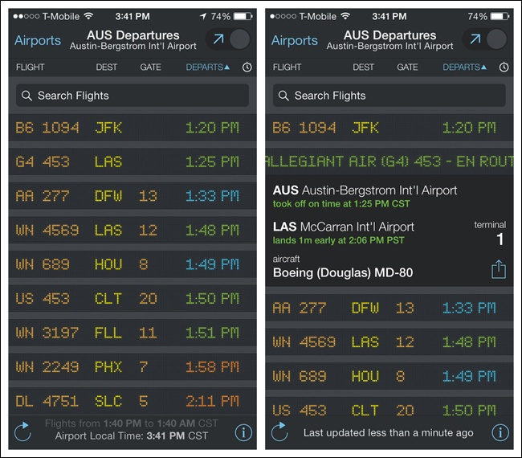
Persistent Navigation: Skeuomorphism, cont’d
FlightBoard
for iOS
Mobile Design Pattern Gallery, 2nd ed.
by Theresa Neil
O’Reilly, 2014

Slide 36
Transient Navigation
Navigation menus remain hidden until the user reveals them.
Menus disappear after the user makes a selection.

Slide 37
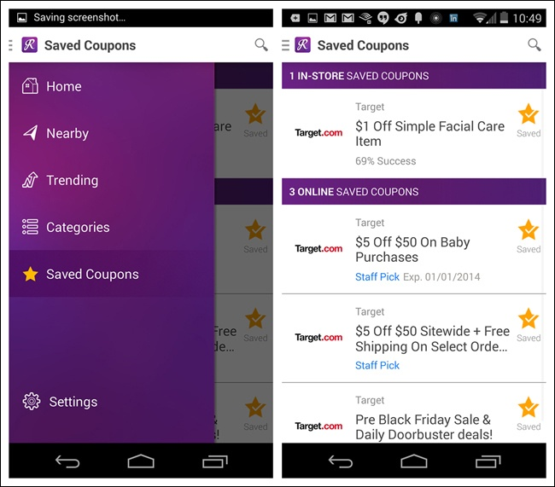
Transient Navigation: Overlay Side Drawer
A swipe or tap reveals a drawer that covers the original screen content.
RetailMeNot
for Android
Mobile Design Pattern Gallery, 2nd ed.
by Theresa Neil
O’Reilly, 2014

Slide 38
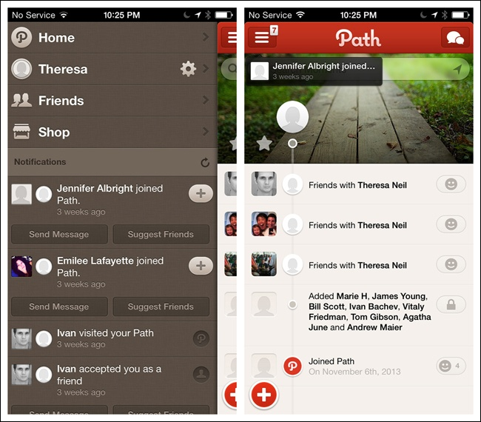
Transient Navigation: Inlay Side Drawer
A swipe or tap opens a drawer that pushes the original content partially off-screen.
Path
for iOS
Mobile Design Pattern Gallery, 2nd ed.
by Theresa Neil
O’Reilly, 2014

Slide 39
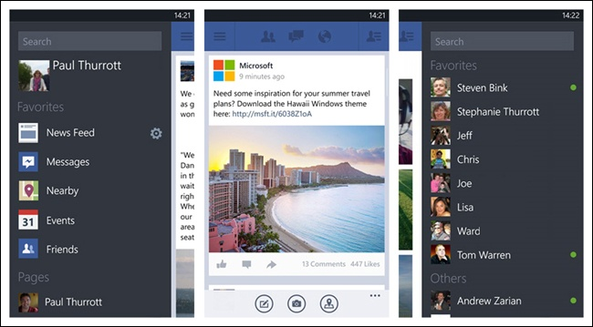
Transient Navigation: Dual Side Drawers
Facebook beta for Windows Phone
Mobile Design Pattern Gallery, 2nd ed.
by Theresa Neil
O’Reilly, 2014

Slide 40
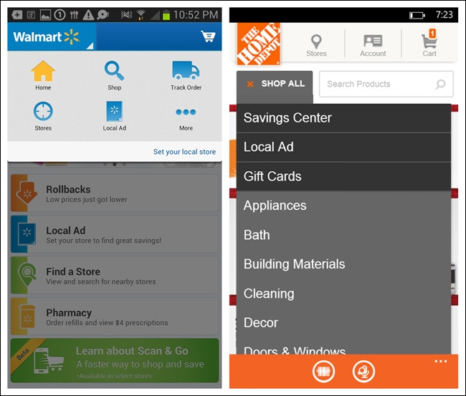
Transient Navigation: Toggle Menu
Tap to reveal the menu.
Walmart
for Android
Home Depot
for Windows Phone
Mobile Design Pattern Gallery, 2nd ed.
by Theresa Neil
O’Reilly, 2014

Slide 41
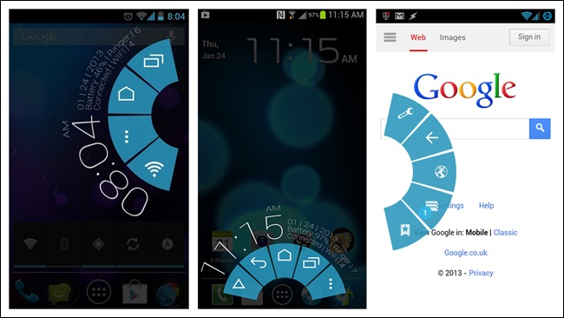
Transient Navigation: Pie Menu
Probably should be avoided.
Paranoid Android OS
Mobile Design Pattern Gallery, 2nd ed.
by Theresa Neil
O’Reilly, 2014

Slide 42
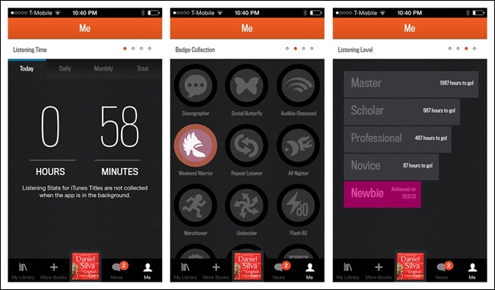
Transient Navigation: Page Swiping
Use page indicators to indicate navigation.
Audible for iOS
Mobile Design Pattern Gallery, 2nd ed.
by Theresa Neil
O’Reilly, 2014

Slide 43
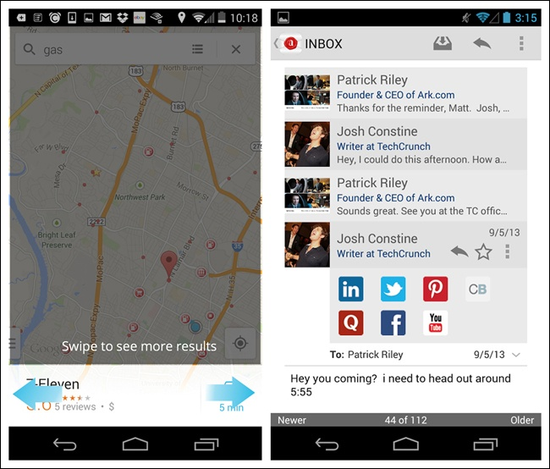
Transient Navigation: Page Swiping, cont’d
Android page indicators
Google Maps
for Android
Ark Mail
for Android
Mobile Design Pattern Gallery, 2nd ed.
by Theresa Neil
O’Reilly, 2014

Slide 44
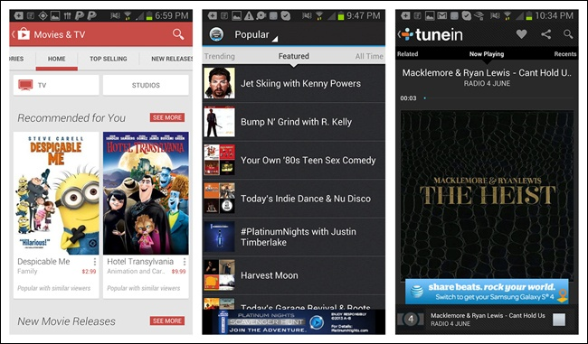
Transient Navigation: Android Scrolling Tabs
Useful to display multiple views in a module.
Often an affordance to swipe horizontally.
Google Play
Songza
TuneIn
Mobile Design Pattern Gallery, 2nd ed.
by Theresa Neil
O’Reilly, 2014

Slide 45
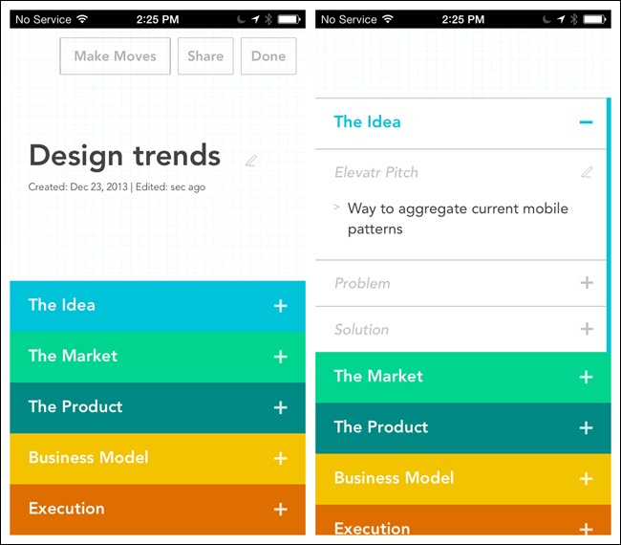
Transient Navigation: Accordion
See more information on the same screen.
Elevator
for iOS
Mobile Design Pattern Gallery, 2nd ed.
by Theresa Neil
O’Reilly, 2014

Slide 46
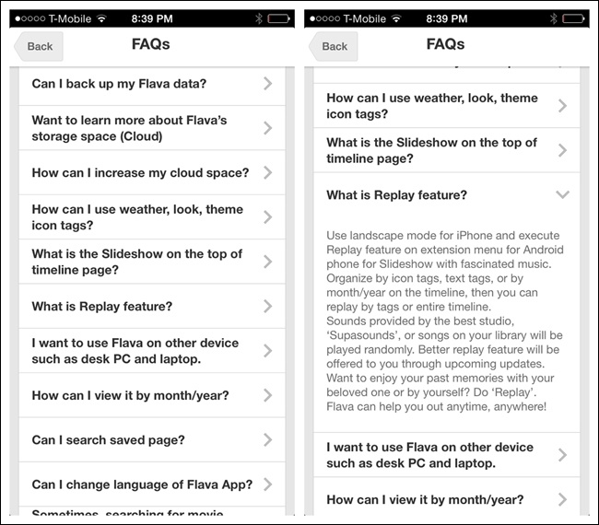
Transient Navigation: Accordion, cont’d
Flava
for iOS
Mobile Design Pattern Gallery, 2nd ed.
by Theresa Neil
O’Reilly, 2014

Slide 47
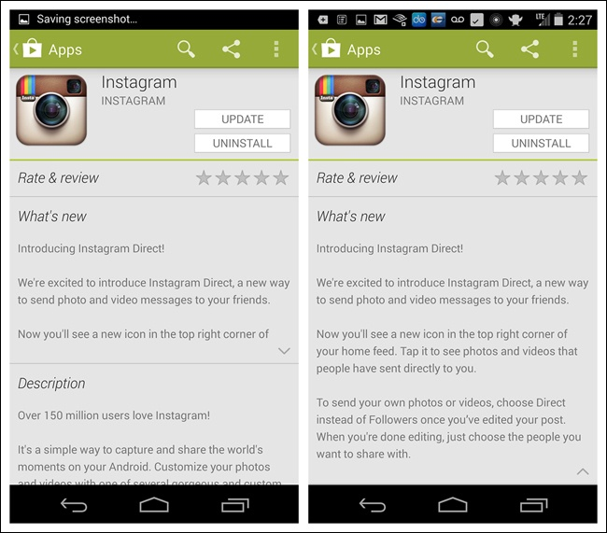
Transient Navigation: Accordion, cont’d
Play Store
for Android
Mobile Design Pattern Gallery, 2nd ed.
by Theresa Neil
O’Reilly, 2014

